Slide 1







A WEB-BASED ONLINE DOCUMENT MANAGEMENT SYSTEM FOR DEPARTMENT OF STUDENT AFFAIRS IN JHCSC PAGADIAN CAMPUS
ALITA 3 FINAL PROGRAMMER
Integrative Programming and Technologies 2 (IT305)
Presented by:
Impil, Marc Jaypee
Tabaranza, Famme
Upao, Raymart
December 17, 2025

Slide 2

INTRODUCTION AND PROBLEM STATEMENT
PROBLEM
taRGET USERS
Manual document submission causes delays
Risk of document misplacement
Poor communication between students & staff
Inefficient processing of forms & reports
Students
Department (DSA)
Organizations (old/new)

Slide 3
PRODUCT SCOPE AND KEY FEATURES
CORE PURPOSE
KEY FEATURES
To provide a digital platform for online document submission, tracking, and processing within JHCSC Pagadian Campus.
User registration & secure login
Dynamic form filling & file uploads
Real-time request status tracking
Email notifications on status changes
Admin dashboard for request and user management

Slide 4

TECHNICAL BACKGROUND
TECHNOLOGIES/TOOLS USED
Frontend: HTML, CSS, JavaScript
Backend: PHP
Database: MySQL
Tools: XAMPP, Composer, Git/GitHub, Visual Studio Code

Slide 5
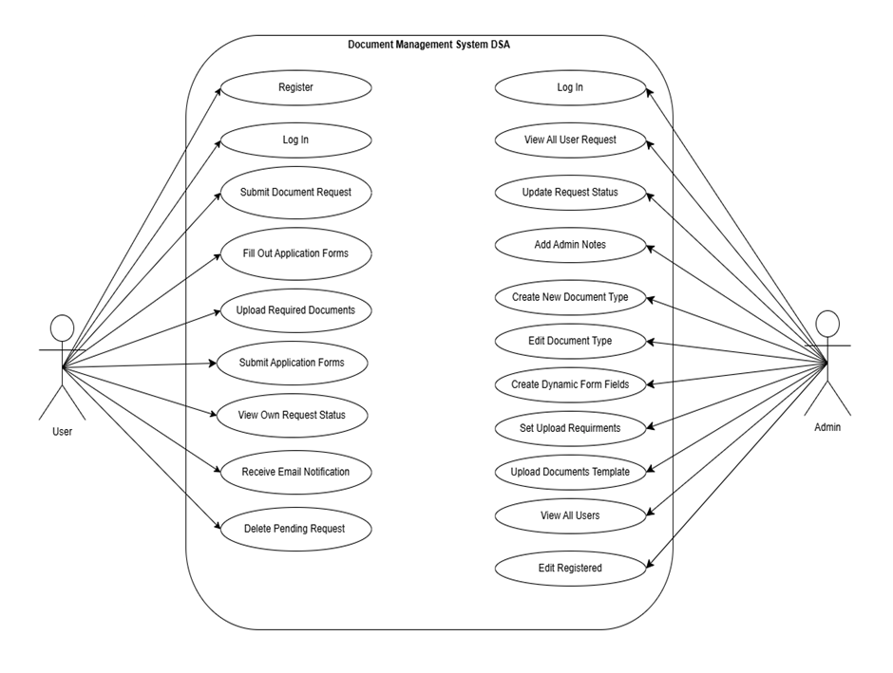
SYSTEM MODELS
USE CASE

Slide 6
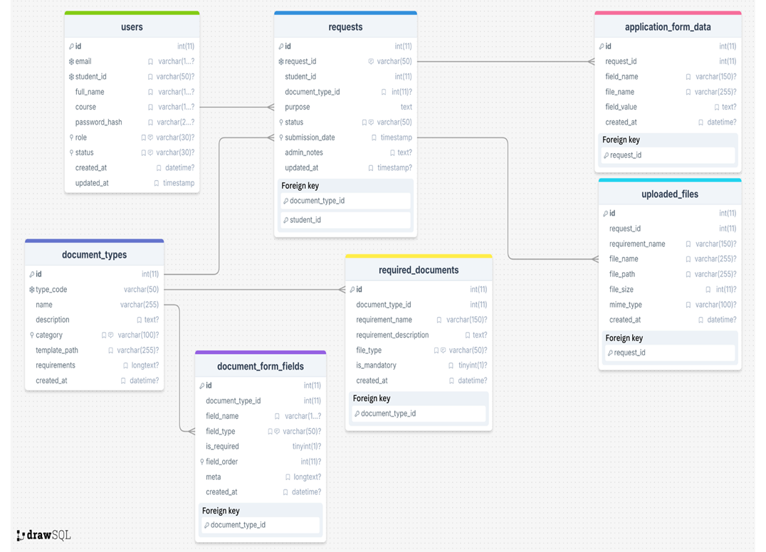
SYSTEM MODELS
DATABASE DESIGN

Slide 7
TESTING AND DEPLOYMENT
TESTING TYPE
ENVIRONMENT
Load Testing
Stress Testing
Windows 11
PHP 8.2.12
MySQL 8.0
TOOLS
Manual testing
Inspect Network
Apache Bench (CLI)
XAMPP local server
DEPLOYMENT
Local server (XAMPP)

Slide 8
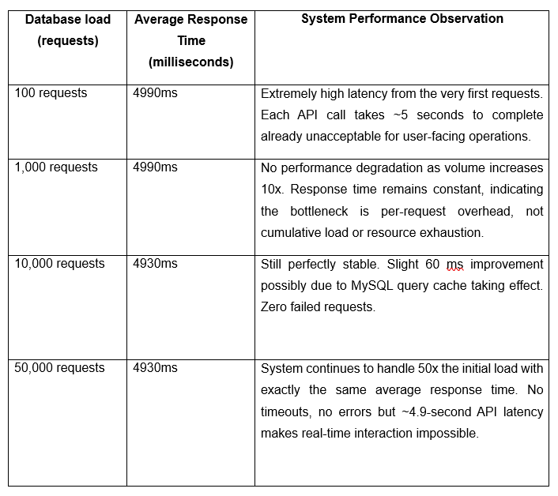
Table 1: Load Test Performance Metrics

Slide 9
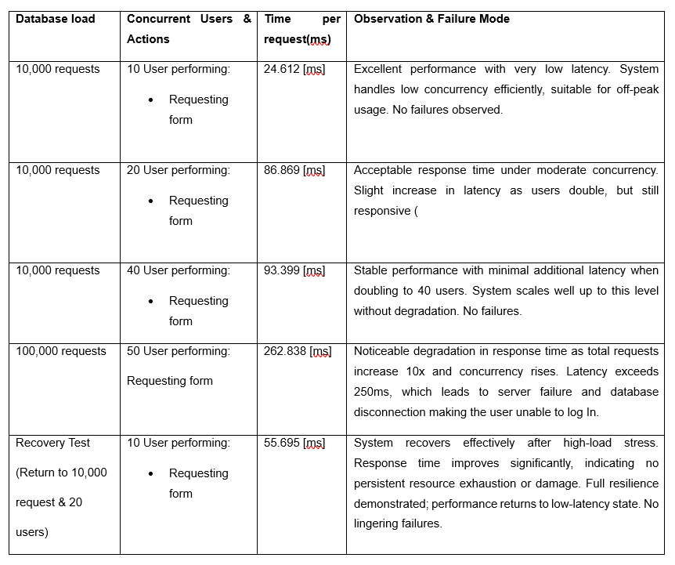
Table 2: Stress Test Performance and Breaking Point Analysis

Slide 10
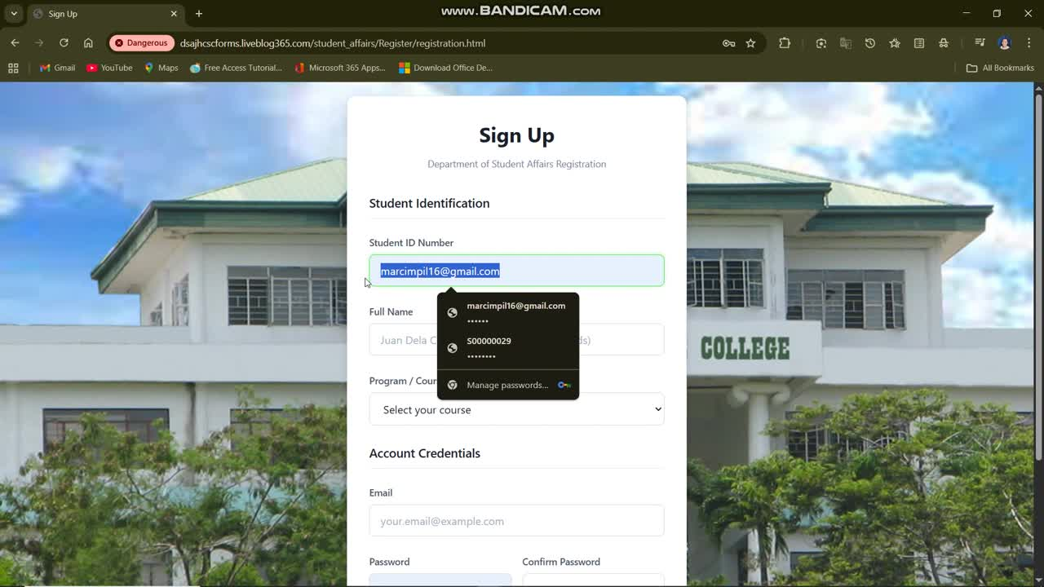
SYSTEM DEMONSTRATION – OVERVIEW
User Registration & Login

Slide 11
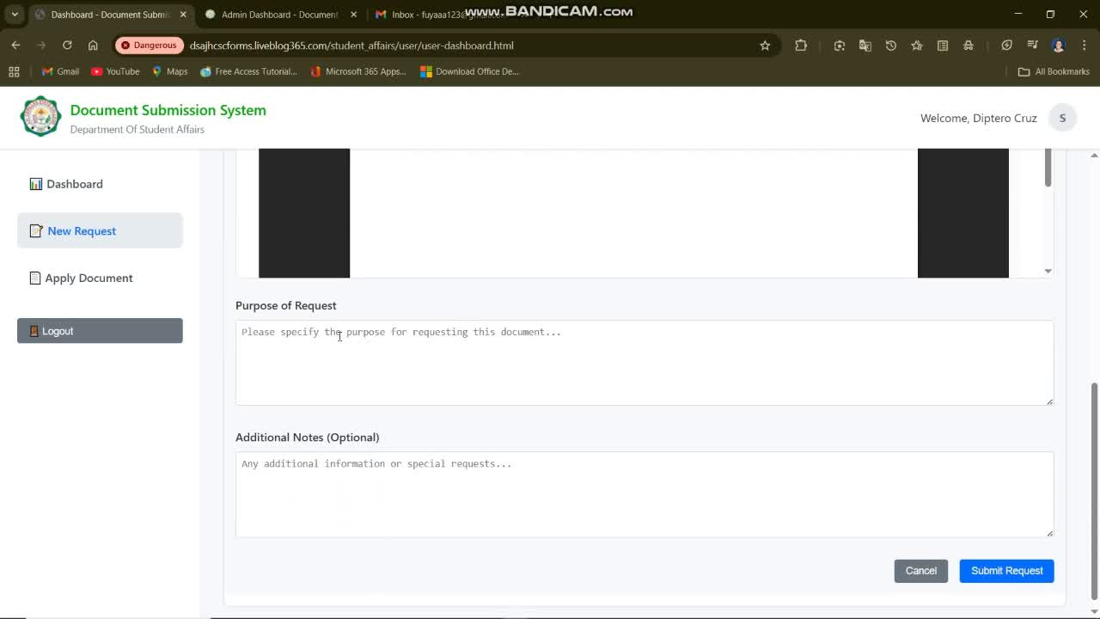
SYSTEM DEMONSTRATION – OVERVIEW
Document Request & Apply Form Fill

Slide 12
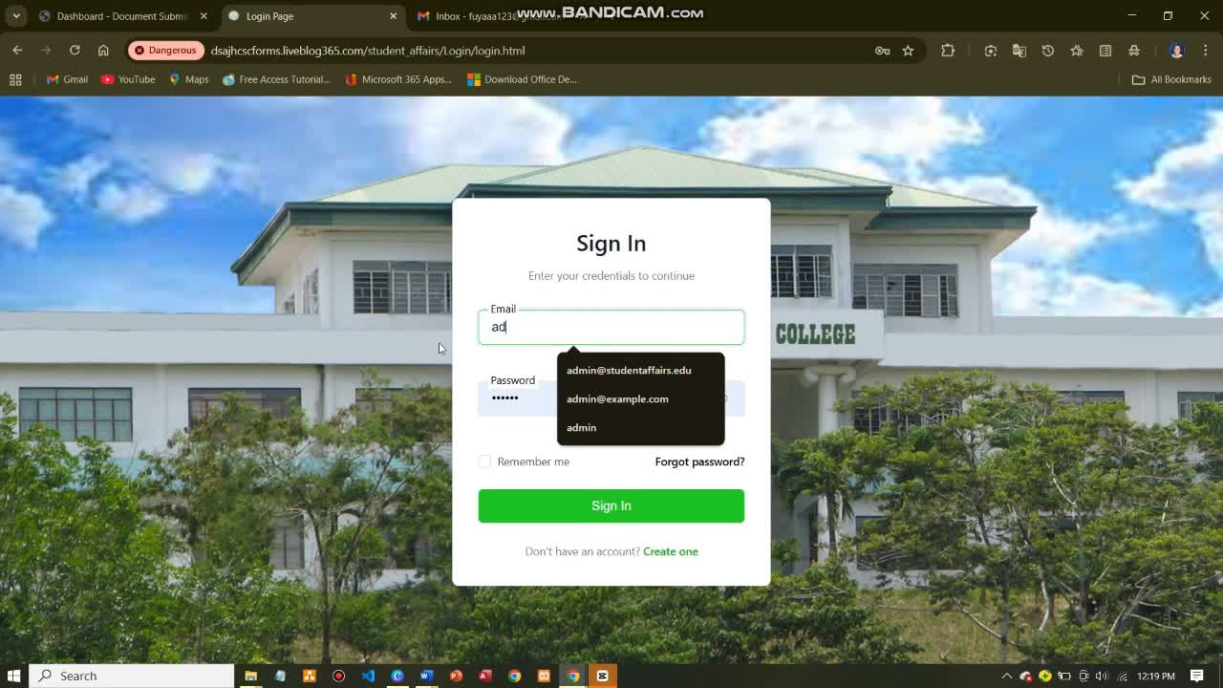
SYSTEM DEMONSTRATION – OVERVIEW
Admin Request Management

Slide 13
A WEB-BASED ONLINE DOCUMENT MANAGEMENT SYSTEM FOR DEPARTMENT OF STUDENT AFFAIRS IN JHCSC PAGADIAN CAMPUS
ALITA 3 FINAL PROGRAMMER
Integrative Programming and Technologies 2 (IT305)
Presented by:
Impil, Marc Jaypee
Tabaranza, Famme
Upao, Raymart
December 17, 2025

